Slide 1

COMS W4111 - Introduction to Databases
(Module II) DBMS Architecture and Implementation: Indexes, Query Processing/Optimization
Donald F. Ferguson (dff@cs.columbia.edu)
Lecture 10: Indexes, Query Processing/Optimization

Slide 2

Reminder
2 | Introduction to Databases (S20): Lecture 10: Indexes, Query Processing/Optimization

Slide 3
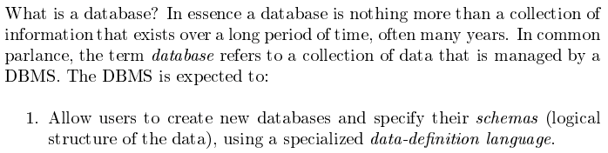
Database Management System Reminder
Covered for the relational model.
Database Systems: The Complete Book (2nd Edition) by Hector Garcia-Molina (Author), Jeffrey D. Ullman (Author), Jennifer Widom (Author)
3 | Introduction to Databases (S20): Lecture 10: Indexes, Query Processing/Optimization © Donald F. Ferguson, 2020

Slide 4
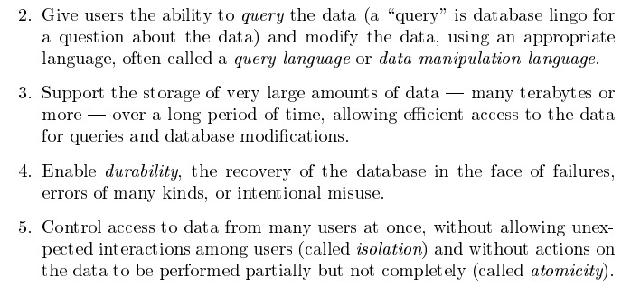
Database Management System Reminder
Focus for next part of course.
Database Systems: The Complete Book (2nd Edition) by Hector Garcia-Molina (Author), Jeffrey D. Ullman (Author), Jennifer Widom (Author)

Slide 5
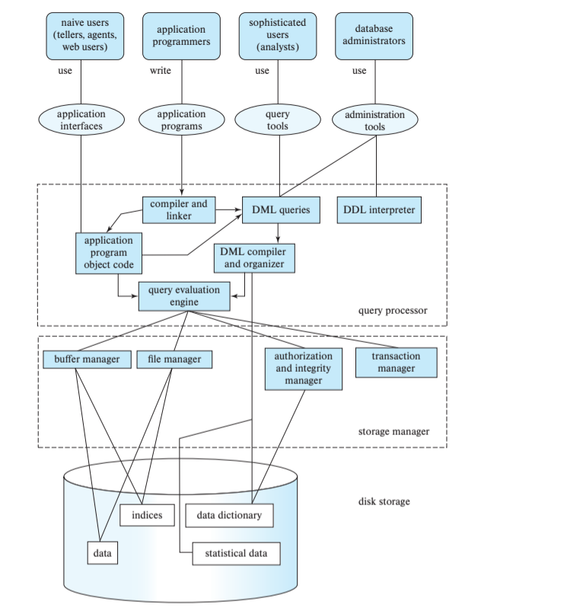
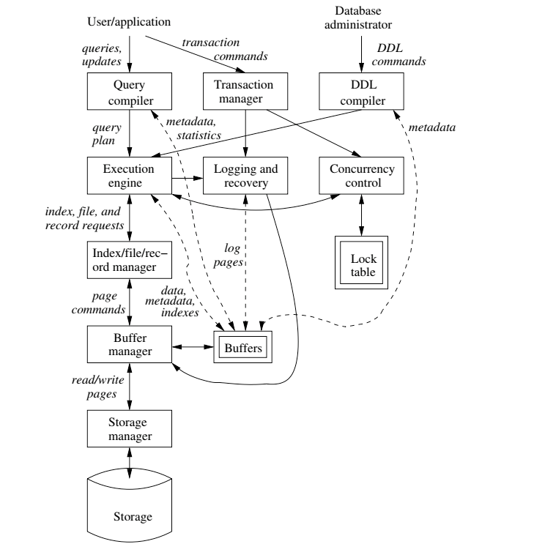
DBMS Subsystems
5 | Introduction to Databases (S20): Lecture 10: Indexes, Query Processing/Optimization © Donald F. Ferguson, 2020

Slide 6

Data Management
Find things quickly.
Access things quickly.
Load/save things quickly.
Database Systems: The Complete Book (2nd Edition) by Hector Garcia-Molina (Author), Jeffrey D. Ullman (Author), Jennifer Widom (Author)

Slide 7
Some Final Thoughts on Disks and Buffers
7 | Introduction to Databases (S20): Lecture 10: Indexes, Query Processing/Optimization

Slide 8
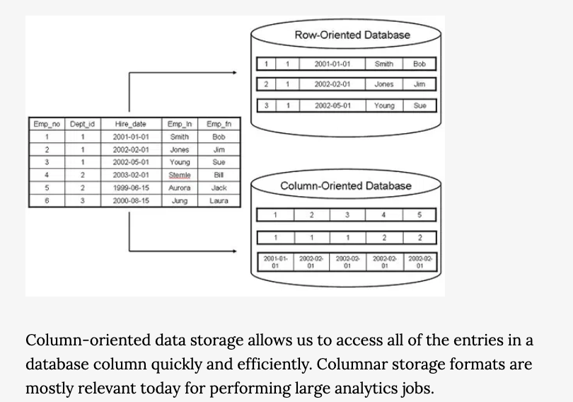
Row versus Columnar Storage
https://softwareengineeringdaily.com/2017/01/13/columnar-data-apache-arrow-and-parquet-with-julien-le-dem-and-jacques-nadeau/

Slide 9
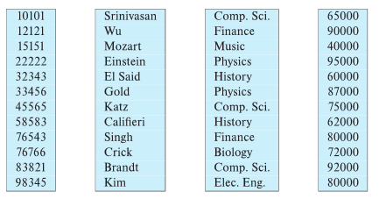
Column-Oriented Storage
Also known as columnar representation
Store each attribute of a relation separately
Example

Slide 10
Columnar Representation
Benefits:
Reduced IO if only some attributes are accessed
Improved CPU cache performance
Improved compression
Vector processing on modern CPU architectures
Drawbacks
Cost of tuple reconstruction from columnar representation
Cost of tuple deletion and update
Cost of decompression
Columnar representation found to be more efficient for decision support than row-oriented representation
Traditional row-oriented representation preferable for transaction processing
Some databases support both representations
Called hybrid row/column stores

Slide 11
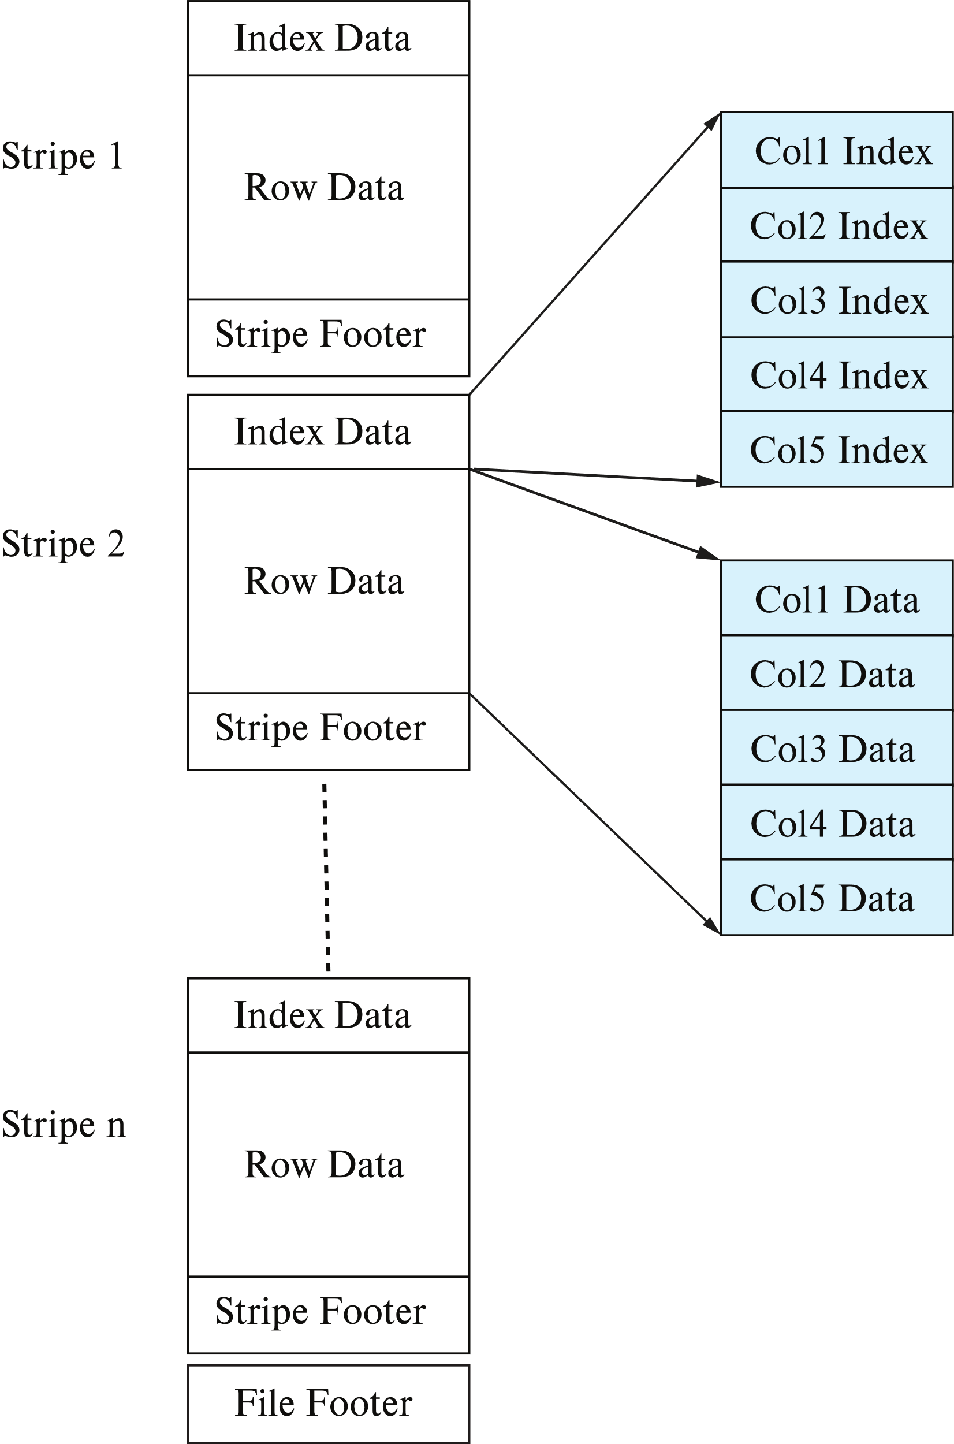
Columnar File Representation
ORC and Parquet: file formats with columnar storage inside file
Very popular for big-data applications
Orc file format shown on right:

Slide 12
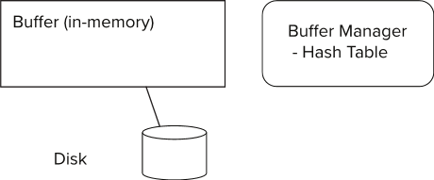
Storage Access
Blocks are units of both storage allocation and data transfer.
Database system seeks to minimize the number of block transfers between the disk and memory. We can reduce the number of disk accesses by keeping as many blocks as possible in main memory.
Buffer – portion of main memory available to store copies of disk blocks.
Buffer manager – subsystem responsible for allocating buffer space in main memory.
Notes:
12

Slide 13
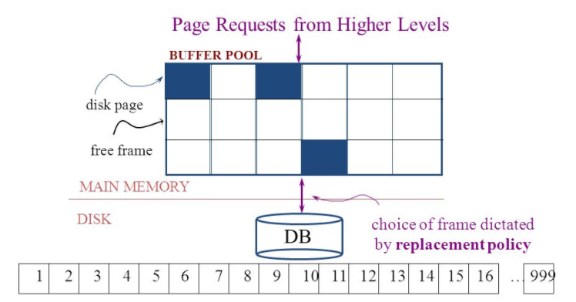
The Logical Concept
The DBMS and queries can only manipulate in-memory blocks and records.
A very, very, very small fraction of all blocks fit in memory.

Slide 14
Buffer Manager
Programs call on the buffer manager when they need a block from disk.
If the block is already in the buffer, buffer manager returns the address of the block in main memory
If the block is not in the buffer, the buffer manager
Allocates space in the buffer for the block
Replacing (throwing out) some other block, if required, to make space for the new block.
Replaced block written back to disk only if it was modified since the most recent time that it was written to/fetched from the disk.
Reads the block from the disk to the buffer, and returns the address of the block in main memory to requester.
Notes:
14

Slide 15
Buffer Manager
Buffer replacement strategy (details coming up!)
Pinned block: memory block that is not allowed to be written back to disk
Pin done before reading/writing data from a block
Unpin done when read /write is complete
Multiple concurrent pin/unpin operations possible
Keep a pin count, buffer block can be evicted only if pin count = 0
Shared and exclusive locks on buffer
Needed to prevent concurrent operations from reading page contents as they are moved/reorganized, and to ensure only one move/reorganize at a time
Readers get shared lock, updates to a block require exclusive lock
Locking rules:
Only one process can get exclusive lock at a time
Shared lock cannot be concurrently with exclusive lock
Multiple processes may be given shared lock concurrently

Slide 16
Buffer-Replacement Policies
Most operating systems replace the block least recently used (LRU strategy)
Idea behind LRU – use past pattern of block references as a predictor of future references
LRU can be bad for some queries
Queries have well-defined access patterns (such as sequential scans), and a database system can use the information in a user’s query to predict future references
Mixed strategy with hints on replacement strategy provided by the query optimizer is preferable
Example of bad access pattern for LRU: when computing the join of 2 relations r and s by a nested loops
for each tuple tr of r do for each tuple ts of s do if the tuples tr and ts match …
Notes:
16

Slide 17
Buffer-Replacement Policies (Cont.)
Toss-immediate strategy – frees the space occupied by a block as soon as the final tuple of that block has been processed
Most recently used (MRU) strategy – system must pin the block currently being processed. After the final tuple of that block has been processed, the block is unpinned, and it becomes the most recently used block.
Buffer manager can use statistical information regarding the probability that a request will reference a particular relation
E.g., the data dictionary is frequently accessed. Heuristic: keep data-dictionary blocks in main memory buffer
Operating system or buffer manager may reorder writes
Can lead to corruption of data structures on disk
E.g., linked list of blocks with missing block on disk
File systems perform consistency check to detect such situations
Careful ordering of writes can avoid many such problems
Notes:
17

Slide 18
Replacement Policy
The replacement policy is one of the most important factors in database management system implementation and configuration.
A very simple, introductory explanation is (https://en.wikipedia.org/wiki/Cache_replacement_policies).
There are a lot of possible policies.
The most efficient caching algorithm would be to always discard the information that will not be needed for the longest time in the future. This optimal result is referred to as Bélády's optimal algorithm/simply optimal replacement policy or the clairvoyant algorithm.
All implementable policies are an attempt to approximate knowledge of the future based on knowledge of the past.
Least Recently Used is based on the simplest assumption
The information that will not be needed for the longest time.
Is the information that has not been accessed for the longest time.

Slide 19
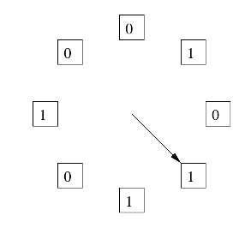
The “Clock Algorithm”
LRU is (perceived to be) expensive
Maintain timestamp for each block.
Update and resort blocks on access.
The “Clock Algorithm” is a less expensive approximation.
Arrange the frames (places blocks can go) into a logical circle like the seconds on a clock face.
Each frame is marked 0 or 1.
Set to 1 when block added to frame.
Or when application accesses a block in frame.
Replacement choice
Sweep second hand clockwise one frame at a time.
If bit is 0, choose for replacement.
If bit is 1, set bit to zero and go to next frame.
The basic idea is. On a clock face
If the second hand is currently at 27 seconds.
The 28 second tick mark is “the least recently touched mark.”

Slide 20
Replacement Algorithm
The algorithms are more sophisticated in the real world, e.g.
“Scans” are common, e.g. go through a large query result in order (will be more clear when discussing cursors).
The engine knows the current position in the result set.
Uses the sort order to determine which records will be accessed soon.
Tags those blocks as not replaceable.
(A form of clairvoyance).
Not all users/applications are equally “important.”
Classify users/applications into priority 1, 2 and 3.
Sub-allocate the buffer pool into pools P1, P2 and P3.
Apply LRU within pools and adjust pool sizes based on relative importance.
This prevents
A high access rate, low-priority application from taking up a lot of frames
Result in low access, high priority applications not getting buffer hits.

Slide 21
Optimization of Disk Block Access (Cont.)
Buffer managers support forced output of blocks for the purpose of recovery (more in Chapter 19)
Nonvolatile write buffers speed up disk writes by writing blocks to a non-volatile RAM or flash buffer immediately
Writes can be reordered to minimize disk arm movement
Log disk – a disk devoted to writing a sequential log of block updates
Used exactly like nonvolatile RAM
Write to log disk is very fast since no seeks are required
Journaling file systems write data in-order to NV-RAM or log disk
Reordering without journaling: risk of corruption of file system data

Slide 22
Indexes (Database Systems Concepts, V7, Ch. 14)
22 | Introduction to Databases (S20): Lecture 10: Indexes, Query Processing/Optimization

Slide 23
Outline
Basic Concepts
Ordered Indices
B⁺-Tree Index Files
B-Tree Index Files
Hashing
Write-optimized indices
Spatio-Temporal Indexing

Slide 24
Basic Concepts
Indexing mechanisms used to speed up access to desired data.
E.g., author catalog in library
Search Key - attribute to set of attributes used to look up records in a file.
An index file consists of records (called index entries) of the form
Index files are typically much smaller than the original file
Two basic kinds of indices:
Ordered indices: search keys are stored in sorted order
Hash indices: search keys are distributed uniformly across “buckets” using a “hash function”.
search-key
pointer

Slide 25
Index Evaluation Metrics
Access types supported efficiently. E.g.,
Records with a specified value in the attribute
Records with an attribute value falling in a specified range of values.
Access time
Insertion time
Deletion time
Space overhead

Slide 26
Ordered Indices
In an ordered index, index entries are stored sorted on the search key value.
Clustering index: in a sequentially ordered file, the index whose search key specifies the sequential order of the file.
Also called primary index
The search key of a primary index is usually but not necessarily the primary key.
Secondary index: an index whose search key specifies an order different from the sequential order of the file. Also called nonclustering index.
Index-sequential file: sequential file ordered on a search key, with a clustering index on the search key.

Slide 27
Dense Index Files
Dense index — Index record appears for every search-key value in the file.
E.g. index on ID attribute of instructor relation

Slide 28
Dense Index Files (Cont.)
Dense index on dept_name, with instructor file sorted on dept_name

Slide 29
Sparse Index Files
Sparse Index: contains index records for only some search-key values.
Applicable when records are sequentially ordered on search-key
To locate a record with search-key value K we:
Find index record with largest search-key value < K
Search file sequentially starting at the record to which the index record points

Slide 30
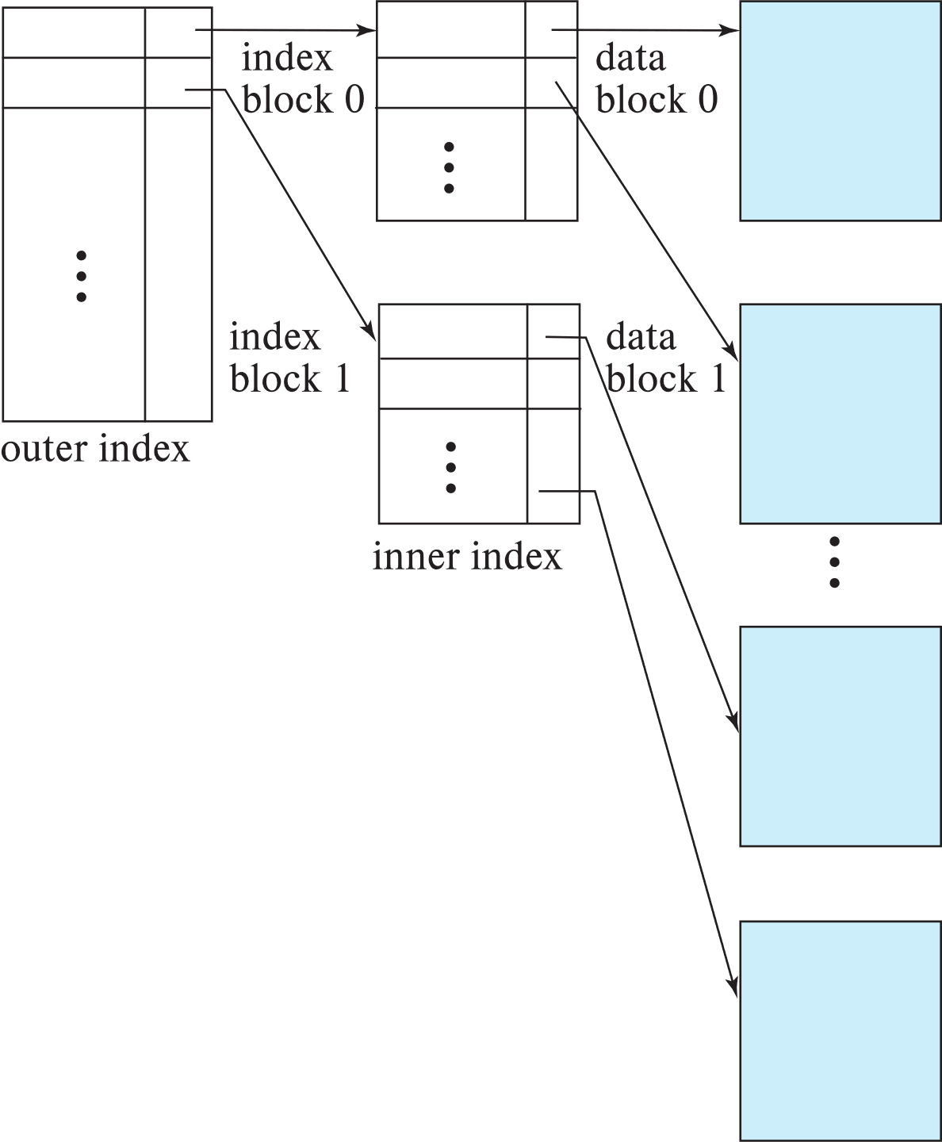
Sparse Index Files (Cont.)
Compared to dense indices:
Less space and less maintenance overhead for insertions and deletions.
Generally slower than dense index for locating records.
Good tradeoff:
for clustered index: sparse index with an index entry for every block in file, corresponding to least search-key value in the block.
For unclustered index: sparse index on top of dense index (multilevel index)

Slide 31
Secondary Indices Example
Secondary index on salary field of instructor
Index record points to a bucket that contains pointers to all the actual records with that particular search-key value.
Secondary indices have to be dense

Slide 32
Clustering vs Nonclustering Indices
Indices offer substantial benefits when searching for records.
BUT: indices imposes overhead on database modification
when a record is inserted or deleted, every index on the relation must be updated
When a record is updated, any index on an updated attribute must be updated
Sequential scan using clustering index is efficient, but a sequential scan using a secondary (nonclustering) index is expensive on magnetic disk
Each record access may fetch a new block from disk
Each block fetch on magnetic disk requires about 5 to 10 milliseconds

Slide 33
Multilevel Index
If index does not fit in memory, access becomes expensive.
Solution: treat index kept on disk as a sequential file and construct a sparse index on it.
outer index – a sparse index of the basic index
inner index – the basic index file
If even outer index is too large to fit in main memory, yet another level of index can be created, and so on.
Indices at all levels must be updated on insertion or deletion from the file.

Slide 34
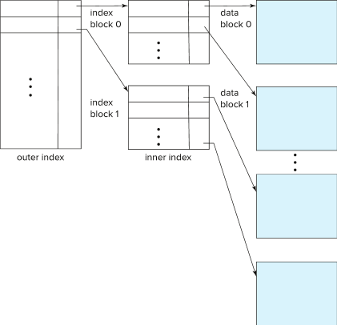
Multilevel Index (Cont.)

Slide 35
Index Update: Deletion
If deleted record was the only record in the file with its particular search-key value, the search-key is deleted from the index also.
Single-level index entry deletion:
Dense indices – deletion of search-key is similar to file record deletion.
Sparse indices –
if an entry for the search key exists in the index, it is deleted by replacing the entry in the index with the next search-key value in the file (in search-key order).
If the next search-key value already has an index entry, the entry is deleted instead of being replaced.

Slide 36
Index Update: Insertion
Single-level index insertion:
Perform a lookup using the search-key value of the record to be inserted.
Dense indices – if the search-key value does not appear in the index, insert it
Indices are maintained as sequential files
Need to create space for new entry, overflow blocks may be required
Sparse indices – if index stores an entry for each block of the file, no change needs to be made to the index unless a new block is created.
If a new block is created, the first search-key value appearing in the new block is inserted into the index.
Multilevel insertion and deletion: algorithms are simple extensions of the single-level algorithms

Slide 37
Indices on Multiple Keys
Composite search key
E.g., index on instructor relation on attributes (name, ID)
Values are sorted lexicographically
E.g. (John, 12121) < (John, 13514) and (John, 13514) < (Peter, 11223)
Can query on just name, or on (name, ID)

Slide 38
B⁺-Tree Index Files
Disadvantage of indexed-sequential files
Performance degrades as file grows, since many overflow blocks get created.
Periodic reorganization of entire file is required.
Advantage of B⁺-tree index files:
Automatically reorganizes itself with small, local, changes, in the face of insertions and deletions.
Reorganization of entire file is not required to maintain performance.
(Minor) disadvantage of B⁺-trees:
Extra insertion and deletion overhead, space overhead.
Advantages of B⁺-trees outweigh disadvantages
B⁺-trees are used extensively

Slide 39
Example of B⁺-Tree

Slide 40
B⁺-Tree Index Files (Cont.)
A B⁺-tree is a rooted tree satisfying the following properties:
All paths from root to leaf are of the same length
Each node that is not a root or a leaf has between ⎡n/2⎤ and n children.
A leaf node has between ⎡(n–1)/2⎤ and n–1 values
Special cases:
If the root is not a leaf, it has at least 2 children.
If the root is a leaf (that is, there are no other nodes in the tree), it can have between 0 and (n–1) values.

Slide 41
B⁺-Tree Node Structure
Typical node
K_{i} are the search-key values
P_{i} are pointers to children (for non-leaf nodes) or pointers to records or buckets of records (for leaf nodes).
The search-keys in a node are ordered
K₁ < K₂ < K₃ < . . . < K_{n–1}
(Initially assume no duplicate keys, address duplicates later)

Slide 42
Leaf Nodes in B⁺-Trees
Properties of a leaf node:
For i = 1, 2, . . ., n–1, pointer P_{i} points to a file record with search-key value K_{i},
If L_{i}, L_{j} are leaf nodes and i < j, L_{i}’s search-key values are less than or equal to L_{j}’s search-key values
P_{n} points to next leaf node in search-key order

Slide 43
Non-Leaf Nodes in B⁺-Trees
Non leaf nodes form a multi-level sparse index on the leaf nodes. For a non-leaf node with m pointers:
All the search-keys in the subtree to which P₁ points are less than K₁
For 2 ≤ i ≤ n – 1, all the search-keys in the subtree to which P_{i} points have values greater than or equal to K_{i–1} and less than K_{i}
All the search-keys in the subtree to which P_{n} points have values greater than or equal to K_{n–1}
General structure

Slide 44
Example of B⁺-tree
B⁺-tree for instructor file (n = 6)
Leaf nodes must have between 3 and 5 values (⎡(n–1)/2⎤ and n –1, with n = 6).
Non-leaf nodes other than root must have between 3 and 6 children (⎡(n/2⎤ and n with n =6).
Root must have at least 2 children.

Slide 45
Observations about B⁺-trees
Since the inter-node connections are done by pointers, “logically” close blocks need not be “physically” close.
The non-leaf levels of the B⁺-tree form a hierarchy of sparse indices.
The B⁺-tree contains a relatively small number of levels
Level below root has at least 2* ⎡n/2⎤ values
Next level has at least 2* ⎡n/2⎤ * ⎡n/2⎤ values
.. etc.
If there are K search-key values in the file, the tree height is no more than ⎡ log_{⎡n/2⎤}(K)⎤
thus searches can be conducted efficiently.
Insertions and deletions to the main file can be handled efficiently, as the index can be restructured in logarithmic time (as we shall see).

Slide 46
Queries on B⁺-Trees
function find(v)
1. C=root
2. while (C is not a leaf node)
Let i be least number s.t. V ≤ K_{i}.
if there is no such number i then
Set C = last non-null pointer in C
else if (v = C.K_{i} ) Set C = P_{i +1}
else set C = C.P_{i}
3. if for some i, K_{i} = V then return C.P_{i}
4. else return null /* no record with search-key value v exists. */

Slide 47
Queries on B⁺-Trees (Cont.)
Range queries find all records with search key values in a given range
See book for details of function findRange(lb, ub) which returns set of all such records
Real implementations usually provide an iterator interface to fetch matching records one at a time, using a next() function

Slide 48
Queries on B⁺⁻Trees (Cont.)
If there are K search-key values in the file, the height of the tree is no more than ⎡log_{⎡n/2⎤}(K)⎤.
A node is generally the same size as a disk block, typically 4 kilobytes
and n is typically around 100 (40 bytes per index entry).
With 1 million search key values and n = 100
at most log₅₀(1,000,000) = 4 nodes are accessed in a lookup traversal from root to leaf.
Contrast this with a balanced binary tree with 1 million search key values — around 20 nodes are accessed in a lookup
above difference is significant since every node access may need a disk I/O, costing around 20 milliseconds

Slide 49
Non-Unique Keys
If a search key a_{i} is not unique, create instead an index on a composite key (a_{i} , A_{p}), which is unique
A_{p} could be a primary key, record ID, or any other attribute that guarantees uniqueness
Search for a_{i} = v can be implemented by a range search on composite key, with range (v, - ∞) to (v, + ∞)
But more I/O operations are needed to fetch the actual records
If the index is clustering, all accesses are sequential
If the index is non-clustering, each record access may need an I/O operation

Slide 50
Updates on B⁺-Trees: Insertion
Assume record already added to the file. Let
pr be pointer to the record, and let
v be the search key value of the record
Find the leaf node in which the search-key value would appear
If there is room in the leaf node, insert (v, pr) pair in the leaf node
Otherwise, split the node (along with the new (v, pr) entry) as discussed in the next slide, and propagate updates to parent nodes.

Slide 51
Updates on B⁺-Trees: Insertion (Cont.)
Splitting a leaf node:
take the n (search-key value, pointer) pairs (including the one being inserted) in sorted order. Place the first ⎡n/2⎤ in the original node, and the rest in a new node.
let the new node be p, and let k be the least key value in p. Insert (k,p) in the parent of the node being split.
If the parent is full, split it and propagate the split further up.
Splitting of nodes proceeds upwards till a node that is not full is found.
In the worst case the root node may be split increasing the height of the tree by 1.
Result of splitting node containing Brandt, Califieri and Crick on inserting Adams
Next step: insert entry with (Califieri, pointer-to-new-node) into parent

Slide 52
B⁺-Tree Insertion
Affected nodes
B⁺-Tree before and after insertion of “Adams”

Slide 53
B⁺-Tree Insertion
B⁺-Tree before and after insertion of “Lamport”
Affected nodes
Affected nodes

Slide 54
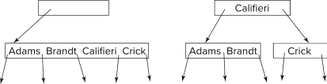
Insertion in B⁺-Trees (Cont.)
Splitting a non-leaf node: when inserting (k,p) into an already full internal node N
Copy N to an in-memory area M with space for n+1 pointers and n keys
Insert (k,p) into M
Copy P₁,K₁, …, K _{⎡n/2⎤-1},P _{⎡n/2⎤} from M back into node N
Copy P_{⎡n/2⎤+1},K _{⎡n/2⎤+1},…,K_{n},P_{n+1} from M into newly allocated node N'
Insert (K _{⎡n/2⎤},N') into parent N
Example
Read pseudocode in book!

Slide 55
Examples of B⁺-Tree Deletion
Before and after deleting “Srinivasan”
Affected nodes
Deleting “Srinivasan” causes merging of under-full leaves

Slide 56
Examples of B⁺-Tree Deletion (Cont.)
Before and after deleting “Singh” and “Wu”
Affected nodes
Leaf containing Singh and Wu became underfull, and borrowed a value Kim from its left sibling
Search-key value in the parent changes as a result

Slide 57
Example of B⁺-tree Deletion (Cont.)
Before and after deletion of “Gold”
Node with Gold and Katz became underfull, and was merged with its sibling
Parent node becomes underfull, and is merged with its sibling
Value separating two nodes (at the parent) is pulled down when merging
Root node then has only one child, and is deleted

Slide 58
Updates on B⁺-Trees: Deletion
Assume record already deleted from file. Let V be the search key value of the record, and Pr be the pointer to the record.
Remove (Pr, V) from the leaf node
If the node has too few entries due to the removal, and the entries in the node and a sibling fit into a single node, then merge siblings:
Insert all the search-key values in the two nodes into a single node (the one on the left), and delete the other node.
Delete the pair (K_{i–1}, P_{i}), where P_{i} is the pointer to the deleted node, from its parent, recursively using the above procedure.

Slide 59
Updates on B⁺-Trees: Deletion
Otherwise, if the node has too few entries due to the removal, but the entries in the node and a sibling do not fit into a single node, then redistribute pointers:
Redistribute the pointers between the node and a sibling such that both have more than the minimum number of entries.
Update the corresponding search-key value in the parent of the node.
The node deletions may cascade upwards till a node which has ⎡n/2⎤ or more pointers is found.
If the root node has only one pointer after deletion, it is deleted and the sole child becomes the root.

Slide 60
Complexity of Updates
Cost (in terms of number of I/O operations) of insertion and deletion of a single entry proportional to height of the tree
With K entries and maximum fanout of n, worst case complexity of insert/delete of an entry is O(log_{⎡n/2⎤}(K))
In practice, number of I/O operations is less:
Internal nodes tend to be in buffer
Splits/merges are rare, most insert/delete operations only affect a leaf node
Average node occupancy depends on insertion order
2/3rds with random, ½ with insertion in sorted order

Slide 61
Non-Unique Search Keys
Alternatives to scheme described earlier
Buckets on separate block (bad idea)
List of tuple pointers with each key
Extra code to handle long lists
Deletion of a tuple can be expensive if there are many duplicates on search key (why?)
Worst case complexity may be linear!
Low space overhead, no extra cost for queries
Make search key unique by adding a record-identifier
Extra storage overhead for keys
Simpler code for insertion/deletion
Widely used
Notes:
61

Slide 62
B⁺-Tree File Organization
B⁺-Tree File Organization:
Leaf nodes in a B⁺-tree file organization store records, instead of pointers
Helps keep data records clustered even when there are insertions/deletions/updates
Leaf nodes are still required to be half full
Since records are larger than pointers, the maximum number of records that can be stored in a leaf node is less than the number of pointers in a nonleaf node.
Insertion and deletion are handled in the same way as insertion and deletion of entries in a B⁺-tree index.

Slide 63
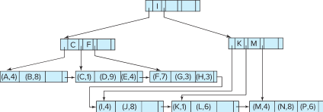
B⁺-Tree File Organization (Cont.)
Example of B+-tree File Organization
Good space utilization important since records use more space than pointers.
To improve space utilization, involve more sibling nodes in redistribution during splits and merges
Involving 2 siblings in redistribution (to avoid split / merge where possible) results in each node having at least entries

Slide 64
Other Issues in Indexing
Record relocation and secondary indices
If a record moves, all secondary indices that store record pointers have to be updated
Node splits in B⁺-tree file organizations become very expensive
Solution: use search key of B⁺-tree file organization instead of record pointer in secondary index
Add record-id if B⁺-tree file organization search key is non-unique
Extra traversal of file organization to locate record
Higher cost for queries, but node splits are cheap
Notes:
64

Slide 65
Indexing Strings
Variable length strings as keys
Variable fanout
Use space utilization as criterion for splitting, not number of pointers
Prefix compression
Key values at internal nodes can be prefixes of full key
Keep enough characters to distinguish entries in the subtrees separated by the key value
E.g., “Silas” and “Silberschatz” can be separated by “Silb”
Keys in leaf node can be compressed by sharing common prefixes

Slide 66
Bulk Loading and Bottom-Up Build
Inserting entries one-at-a-time into a B⁺-tree requires ≥ 1 IO per entry
assuming leaf level does not fit in memory
can be very inefficient for loading a large number of entries at a time (bulk loading)
Efficient alternative 1:
sort entries first (using efficient external-memory sort algorithms discussed later in Section 12.4)
insert in sorted order
insertion will go to existing page (or cause a split)
much improved IO performance, but most leaf nodes half full
Efficient alternative 2: Bottom-up B⁺-tree construction
As before sort entries
And then create tree layer-by-layer, starting with leaf level
details as an exercise
Implemented as part of bulk-load utility by most database systems

Slide 67
B-Tree Index Files
Similar to B+-tree, but B-tree allows search-key values to appear only once; eliminates redundant storage of search keys.
Search keys in nonleaf nodes appear nowhere else in the B-tree; an additional pointer field for each search key in a nonleaf node must be included.
Generalized B-tree leaf node
Nonleaf node – pointers Bi are the bucket or file record pointers.

Slide 68
B-Tree Index Files (Cont.)
Advantages of B-Tree indices:
May use less tree nodes than a corresponding B⁺-Tree.
Sometimes possible to find search-key value before reaching leaf node.
Disadvantages of B-Tree indices:
Only small fraction of all search-key values are found early
Non-leaf nodes are larger, so fan-out is reduced. Thus, B-Trees typically have greater depth than corresponding B⁺-Tree
Insertion and deletion more complicated than in B⁺-Trees
Implementation is harder than B⁺-Trees.
Typically, advantages of B-Trees do not out weigh disadvantages.

Slide 69
B-Tree Index File Example
B-tree (above) and B+-tree (below) on same data

Slide 70
Indexing on Flash
Random I/O cost much lower on flash
20 to 100 microseconds for read/write
Writes are not in-place, and (eventually) require a more expensive erase
Optimum page size therefore much smaller
Bulk-loading still useful since it minimizes page erases
Write-optimized tree structures (discussed later) have been adapted to minimize page writes for flash-optimized search trees

Slide 71
Indexing in Main Memory
Random access in memory
Much cheaper than on disk/flash
But still expensive compared to cache read
Data structures that make best use of cache preferable
Binary search for a key value within a large B⁺-tree node results in many cache misses
B⁺- trees with small nodes that fit in cache line are preferable to reduce cache misses
Key idea: use large node size to optimize disk access, but structure data within a node using a tree with small node size, instead of using an array.

Slide 72
Hashing

Slide 73
Static Hashing
A bucket is a unit of storage containing one or more entries (a bucket is typically a disk block).
we obtain the bucket of an entry from its search-key value using a hash function
Hash function h is a function from the set of all search-key values K to the set of all bucket addresses B.
Hash function is used to locate entries for access, insertion as well as deletion.
Entries with different search-key values may be mapped to the same bucket; thus entire bucket has to be searched sequentially to locate an entry.
In a hash index, buckets store entries with pointers to records
In a hash file-organization buckets store records

Slide 74
Handling of Bucket Overflows
Bucket overflow can occur because of
Insufficient buckets
Skew in distribution of records. This can occur due to two reasons:
multiple records have same search-key value
chosen hash function produces non-uniform distribution of key values
Although the probability of bucket overflow can be reduced, it cannot be eliminated; it is handled by using overflow buckets.

Slide 75
Handling of Bucket Overflows (Cont.)
Overflow chaining – the overflow buckets of a given bucket are chained together in a linked list.
Above scheme is called closed addressing (also called closed hashing or open hashing depending on the book you use)
An alternative, called open addressing (also called open hashing or closed hashing depending on the book you use) which does not use over- flow buckets, is not suitable for database applications.

Slide 76
Example of Hash File Organization
Hash file organization of instructor file, using dept_name as key (See figure in next slide.)
There are 10 buckets,
The binary representation of the I ^{th} character is assumed to be the integer i.
The hash function returns the sum of the binary representations of the characters modulo 10
E.g. h(Music) = 1 h(History) = 2 h(Physics) = 3 h(Elec. Eng.) = 3

Slide 77
Example of Hash File Organization
Hash file organization of instructor file, using dept_name as key.

Slide 78
Deficiencies of Static Hashing
In static hashing, function h maps search-key values to a fixed set of B of bucket addresses. Databases grow or shrink with time.
If initial number of buckets is too small, and file grows, performance will degrade due to too much overflows.
If space is allocated for anticipated growth, a significant amount of space will be wasted initially (and buckets will be underfull).
If database shrinks, again space will be wasted.
One solution: periodic re-organization of the file with a new hash function
Expensive, disrupts normal operations
Better solution: allow the number of buckets to be modified dynamically.

Slide 79
Dynamic Hashing
Periodic rehashing
If number of entries in a hash table becomes (say) 1.5 times size of hash table,
create new hash table of size (say) 2 times the size of the previous hash table
Rehash all entries to new table
Linear Hashing
Do rehashing in an incremental manner
Extendable Hashing
Tailored to disk based hashing, with buckets shared by multiple hash values
Doubling of # of entries in hash table, without doubling # of buckets

Slide 80
Comparison of Ordered Indexing and Hashing
Cost of periodic re-organization
Relative frequency of insertions and deletions
Is it desirable to optimize average access time at the expense of worst-case access time?
Expected type of queries:
Hashing is generally better at retrieving records having a specified value of the key.
If range queries are common, ordered indices are to be preferred
In practice:
PostgreSQL supports hash indices, but discourages use due to poor performance
Oracle supports static hash organization, but not hash indices
SQLServer supports only B⁺-trees

Slide 81
Multiple-Key Access
Use multiple indices for certain types of queries.
Example:
select ID
from instructor
where dept_name = “Finance” and salary = 80000
Possible strategies for processing query using indices on single attributes:
1. Use index on dept_name to find instructors with department name Finance; test salary = 80000
2. Use index on salary to find instructors with a salary of $80000; test dept_name = “Finance”.
3. Use dept_name index to find pointers to all records pertaining to the “Finance” department. Similarly use index on salary. Take intersection of both sets of pointers obtained.

Slide 82
Indices on Multiple Keys
Composite search keys are search keys containing more than one attribute
E.g., (dept_name, salary)
Lexicographic ordering: (a₁, a₂) < (b₁, b₂) if either
a₁ < b₁, or
a₁=b₁ and a₂ < b₂

Slide 83
Indices on Multiple Attributes
Suppose we have an index on combined search-key
(dept_name, salary).
With the where clause where dept_name = “Finance” and salary = 80000 the index on (dept_name, salary) can be used to fetch only records that satisfy both conditions.
Using separate indices in less efficient — we may fetch many records (or pointers) that satisfy only one of the conditions.
Can also efficiently handle where dept_name = “Finance” and salary < 80000
But cannot efficiently handle where dept_name < “Finance” and balance = 80000
May fetch many records that satisfy the first but not the second condition

Slide 84
Other Features
Covering indices
Add extra attributes to index so (some) queries can avoid fetching the actual records
Store extra attributes only at leaf
Why?
Particularly useful for secondary indices
Why?

Slide 85
Creation of Indices
Example create index takes_pk on takes (ID,course_ID, year, semester, section) drop index takes_pk
Most database systems allow specification of type of index, and clustering.
Indices on primary key created automatically by all databases
Why?
Some database also create indices on foreign key attributes
Why might such an index be useful for this query:
takes ⨝ σ_{name='Shankar'} (student)
Indices can greatly speed up lookups, but impose cost on updates
Index tuning assistants/wizards supported on several databases to help choose indices, based on query and update workload

Slide 86
Index Definition in SQL
Create an index
create index <index-name> on <relation-name> (<attribute-list>)
E.g.,: create index b-index on branch(branch_name)
Use create unique index to indirectly specify and enforce the condition that the search key is a candidate key is a candidate key.
Not really required if SQL unique integrity constraint is supported
To drop an index
drop index <index-name>
Most database systems allow specification of type of index, and clustering.

Slide 87
Query Processing and Optimization (Database Systems Concepts, V7, Ch. 15)
87 | Introduction to Databases (S20): Lecture 10: Indexes, Query Processing/Optimization

Slide 88
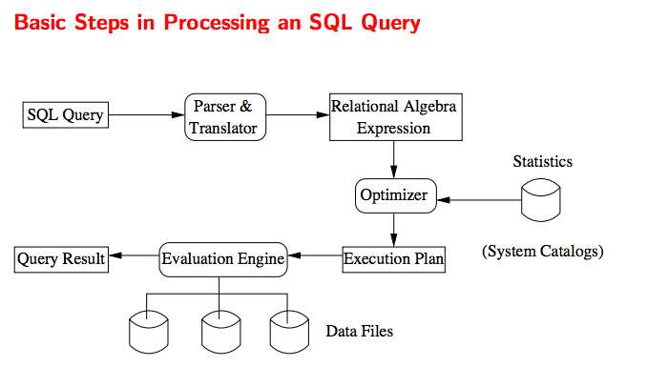
Query Processing and Optimization
88 | Introduction to Databases (S20): Lecture 10: Indexes, Query Processing/Optimization © Donald F. Ferguson, 2020

Slide 89
Chapter 15: Query Processing
Overview
Measures of Query Cost
Selection Operation
Sorting
Join Operation
Other Operations
Evaluation of Expressions

Slide 90
Basic Steps in Query Processing
1. Parsing and translation
2. Optimization
3. Evaluation

Slide 91
Basic Steps in Query Processing (Cont.)
Parsing and translation
translate the query into its internal form. This is then translated into relational algebra.
Parser checks syntax, verifies relations
Evaluation
The query-execution engine takes a query-evaluation plan, executes that plan, and returns the answers to the query.

Slide 92
Basic Steps in Query Processing: Optimization
A relational algebra expression may have many equivalent expressions
E.g., σ_{salary<75000}(∏_{salary}(instructor)) is equivalent to ∏_{salary}(σ_{salary<75000}(instructor))
Each relational algebra operation can be evaluated using one of several different algorithms
Correspondingly, a relational-algebra expression can be evaluated in many ways.
Annotated expression specifying detailed evaluation strategy is called an evaluation-plan. E.g.,:
Use an index on salary to find instructors with salary < 75000,
Or perform complete relation scan and discard instructors with salary ≥ 75000

Slide 93
Basic Steps: Optimization (Cont.)
Query Optimization: Amongst all equivalent evaluation plans choose the one with lowest cost.
Cost is estimated using statistical information from the database catalog
e.g.. number of tuples in each relation, size of tuples, etc.
In this chapter we study
How to measure query costs
Algorithms for evaluating relational algebra operations
How to combine algorithms for individual operations in order to evaluate a complete expression
In Chapter 16
We study how to optimize queries, that is, how to find an evaluation plan with lowest estimated cost

Slide 94
Key value | Record location
a2 | (/usr/local/mysql.data/s1/f1, 1, 4)
a4 | (/usr/local/mysql.data/s1/f1, 2, 3)
Record
Block | 0 | 1 | 2 | 3 | 4 | 5
0
1 |  |  |  |  | a2 record
2 |  |  |  | a4 record
3
4
5
6
Note: can contain data itself
OR a pointer to the data

Slide 95
Measures of Query Cost
Many factors contribute to time cost
disk access, CPU, and network communication
Cost can be measured based on
response time, i.e. total elapsed time for answering query, or
total resource consumption
We use total resource consumption as cost metric
Response time harder to estimate, and minimizing resource consumption is a good idea in a shared database
We ignore CPU costs for simplicity
Real systems do take CPU cost into account
Network costs must be considered for parallel systems
We describe how estimate the cost of each operation
We do not include cost to writing output to disk

Slide 96
Measures of Query Cost
Disk cost can be estimated as:
Number of seeks * average-seek-cost
Number of blocks read * average-block-read-cost
Number of blocks written * average-block-write-cost
For simplicity we just use the number of block transfers from disk and the number of seeks as the cost measures
t_{T} – time to transfer one block
Assuming for simplicity that write cost is same as read cost
t_{S} – time for one seek
Cost for b block transfers plus S seeks b * t_{T} + S * t_{S}
t_{S} and t_{T} depend on where data is stored; with 4 KB blocks:
High end magnetic disk: t_{S} = 4 msec and t_{T} =0.1 msec
SSD: t_{S} = 20-90 microsec and t_{T} = 2-10 microsec for 4KB

Slide 97
Measures of Query Cost (Cont.)
Required data may be buffer resident already, avoiding disk I/O
But hard to take into account for cost estimation
Several algorithms can reduce disk IO by using extra buffer space
Amount of real memory available to buffer depends on other concurrent queries and OS processes, known only during execution
Worst case estimates assume that no data is initially in buffer and only the minimum amount of memory needed for the operation is available
But more optimistic estimates are used in practice
Notes:
97

Slide 98
Selection Operation
File scan
Algorithm A1 (linear search). Scan each file block and test all records to see whether they satisfy the selection condition.
Cost estimate = b_{r} block transfers + 1 seek
b_{r} denotes number of blocks containing records from relation r
If selection is on a key attribute, can stop on finding record
cost = (b_{r} /2) block transfers + 1 seek
Linear search can be applied regardless of
selection condition or
ordering of records in the file, or
availability of indices
Note: binary search generally does not make sense since data is not stored consecutively
except when there is an index available,
and binary search requires more seeks than index search
Notes:
Example: WHERE clause
If blocks are together on a disk, can just do transfer + seek
Don’t need to worry about this for class..
But know that where blocks are on the disk does matter for cost
Linear search: read every block and see if record within block matches (no index use)

Slide 99
Selections Using Indices
Index scan – search algorithms that use an index
selection condition must be on search-key of index.
A2 (clustering index, equality on key). Retrieve a single record that satisfies the corresponding equality condition
Cost = (h_{i} + 1) * (t_{T} + t_{S})
A3 (clustering index, equality on nonkey) Retrieve multiple records.
Records will be on consecutive blocks
Let b = number of blocks containing matching records
Cost = h_{i} * (t_{T} + t_{S}) + t_{S} + t_{T} * b
Notes:
CLUSTERED INDEX: Cost is depth of index tree (indexes are clustered on same block)
IF NOT CLUSTERED INDEX:
Still need to scan after hitting index

Slide 100
Selections Using Indices
A4 (secondary index, equality on key/non-key).
Retrieve a single record if the search-key is a candidate key
Cost = (h_{i} + 1) * (t_{T} + t_{S})
Retrieve multiple records if search-key is not a candidate key
each of n matching records may be on a different block
Cost = (h_{i} + n) * (t_{T} + t_{S})
Can be very expensive!
Notes:
100

Slide 101
Selections Involving Comparisons
Can implement selections of the form σ_{A≤V} (r) or σ_{A ≥ V}(r) by using
a linear file scan,
or by using indices in the following ways:
A5 (clustering index, comparison). (Relation is sorted on A)
For σ_{A ≥ V}(r) use index to find first tuple ≥ v and scan relation sequentially from there
For σ_{A≤V} (r) just scan relation sequentially till first tuple > v; do not use index
A6 (clustering index, comparison).
For σ_{A ≥ V}(r) use index to find first index entry ≥ v and scan index sequentially from there, to find pointers to records.
For σ_{A≤V} (r) just scan leaf pages of index finding pointers to records, till first entry > v
In either case, retrieve records that are pointed to
requires an I/O per record; Linear file scan may be cheaper!

Slide 102
Implementation of Complex Selections
Conjunction: σ_{θ1}∧ _{θ2}∧. . . _{θn}(r)
A7 (conjunctive selection using one index).
Select a combination of θ_{i} and algorithms A1 through A7 that results in the least cost for σ_{θi} (r).
Test other conditions on tuple after fetching it into memory buffer.
A8 (conjunctive selection using composite index).
Use appropriate composite (multiple-key) index if available.
A9 (conjunctive selection by intersection of identifiers).
Requires indices with record pointers.
Use corresponding index for each condition, and take intersection of all the obtained sets of record pointers.
Then fetch records from file
If some conditions do not have appropriate indices, apply test in memory.

Slide 103
Algorithms for Complex Selections
Disjunction:σ_{θ1}∨ _{θ2} ∨. . . _{θn} (r).
A10 (disjunctive selection by union of identifiers).
Applicable if all conditions have available indices.
Otherwise use linear scan.
Use corresponding index for each condition, and take union of all the obtained sets of record pointers.
Then fetch records from file
Negation: σ_{¬θ}(r)
Use linear scan on file
If very few records satisfy ¬θ, and an index is applicable to θ
Find satisfying records using index and fetch from file

Slide 104
Bitmap Index Scan
The bitmap index scan algorithm of PostgreSQL
Bridges gap between secondary index scan and linear file scan when number of matching records is not known before execution
Bitmap with 1 bit per page in relation
Steps:
Index scan used to find record ids, and set bit of corresponding page in bitmap
Linear file scan fetching only pages with bit set to 1
Performance
Similar to index scan when only a few bits are set
Similar to linear file scan when most bits are set
Never behaves very badly compared to best alternative

Slide 105
Sorting
We may build an index on the relation, and then use the index to read the relation in sorted order. May lead to one disk block access for each tuple.
For relations that fit in memory, techniques like quicksort can be used.
For relations that don’t fit in memory, external sort-merge is a good choice.

Slide 106
Example: External Sorting Using Sort-Merge

Slide 107
External Sort-Merge
Let M denote memory size (in pages).
1. Create sorted runs. Let i be 0 initially. Repeatedly do the following till the end of the relation: (a) Read M blocks of relation into memory (b) Sort the in-memory blocks (c) Write sorted data to run R_{i}; increment i.
Let the final value of i be N
2. Merge the runs (next slide)…..

Slide 108
External Sort-Merge (Cont.)
2. Merge the runs (N-way merge). We assume (for now) that N < M.
1. Use N blocks of memory to buffer input runs, and 1 block to buffer output. Read the first block of each run into its buffer page
2. repeat
Select the first record (in sort order) among all buffer pages
Write the record to the output buffer. If the output buffer is full write it to disk.
Delete the record from its input buffer page. If the buffer page becomes empty then read the next block (if any) of the run into the buffer.
3. until all input buffer pages are empty:

Slide 109
External Sort-Merge (Cont.)
If N ≥ M, several merge passes are required.
In each pass, contiguous groups of M - 1 runs are merged.
A pass reduces the number of runs by a factor of M -1, and creates runs longer by the same factor.
E.g. If M=11, and there are 90 runs, one pass reduces the number of runs to 9, each 10 times the size of the initial runs
Repeated passes are performed till all runs have been merged into one.

Slide 110
External Merge Sort (Cont.)
Cost analysis:
1 block per run leads to too many seeks during merge
Instead use b_{b} buffer blocks per run
➔ read/write b_{b} blocks at a time
Can merge ⎣M/b_{b}⎦–1 runs in one pass
Total number of merge passes required: ⎡log _{⎣M/bb⎦–1}(b_{r}/M)⎤.
Block transfers for initial run creation as well as in each pass is 2b_{r}
for final pass, we don’t count write cost
we ignore final write cost for all operations since the output of an operation may be sent to the parent operation without being written to disk
Thus total number of block transfers for external sorting: b_{r} ( 2 ⎡log _{⎣M/bb⎦–1} (b_{r} / M)⎤ + 1) ⎡
Seeks: next slide

Slide 111
External Merge Sort (Cont.)
Cost of seeks
During run generation: one seek to read each run and one seek to write each run
2 ⎡b_{r} / M⎤
During the merge phase
Need 2 ⎡b_{r} / b_{b}⎤ seeks for each merge pass
except the final one which does not require a write
Total number of seeks: 2 ⎡b_{r} / M⎤ + ⎡b_{r} / b_{b}⎤ (2 ⎡log_{⎣M/bb⎦–1}(b_{r} / M)⎤ -1)

Slide 112
Join Operation
Several different algorithms to implement joins
Nested-loop join
Block nested-loop join
Indexed nested-loop join
Merge-join
Hash-join
Choice based on cost estimate
Examples use the following information
Number of records of student: 5,000 takes: 10,000
Number of blocks of student: 100 takes: 400

Slide 113
Nested-Loop Join
To compute the theta join r ⨝ _{θ} s for each tuple t_{r} in r do begin for each tuple t_{s} in s do begin test pair (t_{r},t_{s}) to see if they satisfy the join condition θ if they do, add t_{r} • t_{s} to the result. end end
r is called the outer relation and s the inner relation of the join.
Requires no indices and can be used with any kind of join condition.
Expensive since it examines every pair of tuples in the two relations.

Slide 114
Nested-Loop Join (Cont.)
In the worst case, if there is enough memory only to hold one block of each relation, the estimated cost is n_{r} ∗ b_{s} + b_{r} block transfers, plus n_{r} + b_{r} seeks
If the smaller relation fits entirely in memory, use that as the inner relation.
Reduces cost to b_{r} + b_{s} block transfers and 2 seeks
Assuming worst case memory availability cost estimate is
with student as outer relation:
5000 ∗ 400 + 100 = 2,000,100 block transfers,
5000 + 100 = 5100 seeks
with takes as the outer relation
10000 ∗ 100 + 400 = 1,000,400 block transfers and 10,400 seeks
If smaller relation (student) fits entirely in memory, the cost estimate will be 500 block transfers.
Block nested-loops algorithm (next slide) is preferable.

Slide 115
Block Nested-Loop Join
Variant of nested-loop join in which every block of inner relation is paired with every block of outer relation.
for each block B_{r} of r do begin for each block B_{s} of s do begin for each tuple t_{r} in B_{r} do begin for each tuple t_{s} in B_{s} do begin Check if (t_{r},t_{s}) satisfy the join condition if they do, add t_{r} • t_{s} to the result. end end end end

Slide 116
Block Nested-Loop Join (Cont.)
Worst case estimate: b_{r} ∗ b_{s} + b_{r} block transfers + 2 * b_{r} seeks
Each block in the inner relation s is read once for each block in the outer relation
Best case: b_{r} + b_{s} block transfers + 2 seeks.
Improvements to nested loop and block nested loop algorithms:
In block nested-loop, use M — 2 disk blocks as blocking unit for outer relations, where M = memory size in blocks; use remaining two blocks to buffer inner relation and output
Cost = ⎡b_{r} / (M-2)⎤ ∗ b_{s} + b_{r} block transfers + 2 ⎡b_{r} / (M-2)⎤ seeks
If equi-join attribute forms a key or inner relation, stop inner loop on first match
Scan inner loop forward and backward alternately, to make use of the blocks remaining in buffer (with LRU replacement)
Use index on inner relation if available (next slide)

Slide 117
Indexed Nested-Loop Join
Index lookups can replace file scans if
join is an equi-join or natural join and
an index is available on the inner relation’s join attribute
Can construct an index just to compute a join.
For each tuple t_{r} in the outer relation r, use the index to look up tuples in s that satisfy the join condition with tuple t_{r}.
Worst case: buffer has space for only one page of r, and, for each tuple in r, we perform an index lookup on s.
Cost of the join: b_{r} (t_{T} + t_{S}) + n_{r} ∗ c
Where c is the cost of traversing index and fetching all matching s tuples for one tuple or r
c can be estimated as cost of a single selection on s using the join condition.
If indices are available on join attributes of both r and s, use the relation with fewer tuples as the outer relation.

Slide 118
Example of Nested-Loop Join Costs
Compute student ⨝ takes, with student as the outer relation.
Let takes have a primary B⁺-tree index on the attribute ID, which contains 20 entries in each index node.
Since takes has 10,000 tuples, the height of the tree is 4, and one more access is needed to find the actual data
student has 5000 tuples
Cost of block nested loops join
400*100 + 100 = 40,100 block transfers + 2 * 100 = 200 seeks
assuming worst case memory
may be significantly less with more memory
Cost of indexed nested loops join
100 + 5000 * 5 = 25,100 block transfers and seeks.
CPU cost likely to be less than that for block nested loops join

Slide 119
Merge-Join
1. Sort both relations on their join attribute (if not already sorted on the join
attributes).
2. Merge the sorted relations to join them
1. Join step is similar to the merge stage of the sort-merge algorithm.
2. Main difference is handling of duplicate values in join attribute —
every pair with same value on join attribute must be matched
3. Detailed algorithm in book

Slide 120
Merge-Join (Cont.)
Can be used only for equi-joins and natural joins
Each block needs to be read only once (assuming all tuples for any given value of the join attributes fit in memory
Thus the cost of merge join is: b_{r} + b_{s} block transfers + ⎡b_{r} / b_{b}⎤ + ⎡b_{s} / b_{b}⎤ seeks
+ the cost of sorting if relations are unsorted.
hybrid merge-join: If one relation is sorted, and the other has a secondary B⁺-tree index on the join attribute
Merge the sorted relation with the leaf entries of the B⁺-tree .
Sort the result on the addresses of the unsorted relation’s tuples
Scan the unsorted relation in physical address order and merge with previous result, to replace addresses by the actual tuples
Sequential scan more efficient than random lookup

Slide 121
Hash-Join
Applicable for equi-joins and natural joins.
A hash function h is used to partition tuples of both relations
h maps JoinAttrs values to {0, 1, ..., n}, where JoinAttrs denotes the common attributes of r and s used in the natural join.
r₀, r₁, . . ., r_{n} denote partitions of r tuples
Each tuple t_{r} ∈ r is put in partition r_{i} where i = h(t_{r} [JoinAttrs]).
r₀,, r₁. . ., r_{n} denotes partitions of s tuples
Each tuple t_{s} ∈s is put in partition s_{i}, where i = h(t_{s} [JoinAttrs]).
Note: In book, Figure 12.10 r_{i} is denoted as H_{ri,} s_{i} is denoted as H_{si} and n is denoted as n_{h.}

Slide 122
Hash-Join (Cont.)

Slide 123
Hash-Join (Cont.)
r tuples in r_{i} need only to be compared with s tuples in s_{i} Need not be compared with s tuples in any other partition, since:
an r tuple and an s tuple that satisfy the join condition will have the same value for the join attributes.
If that value is hashed to some value i, the r tuple has to be in r_{i} and the s tuple in s_{i}.

Slide 124
Hash-Join Algorithm
The hash-join of r and s is computed as follows.
1. Partition the relation s using hashing function h. When partitioning a relation, one block of memory is reserved as the output buffer for each partition.
2. Partition r similarly.
3. For each i:
(a) Load s_{i} into memory and build an in-memory hash index on it using the join attribute. This hash index uses a different hash function than the earlier one h.
(b) Read the tuples in r_{i} from the disk one by one. For each tuple t_{r} locate each matching tuple t_{s} in s_{i} using the in-memory hash index. Output the concatenation of their attributes.
Relation s is called the build input and r is called the probe input.

Slide 125
Hash-Join algorithm (Cont.)
The value n and the hash function h is chosen such that each s_{i} should fit in memory.
Typically n is chosen as ⎡b_{s}/M⎤ * f where f is a “fudge factor”, typically around 1.2
The probe relation partitions s_{i} need not fit in memory
Recursive partitioning required if number of partitions n is greater than number of pages M of memory.
instead of partitioning n ways, use M – 1 partitions for s
Further partition the M – 1 partitions using a different hash function
Use same partitioning method on r
Rarely required: e.g., with block size of 4 KB, recursive partitioning not needed for relations of < 1GB with memory size of 2MB, or relations of < 36 GB with memory of 12 MB

Slide 126
Handling of Overflows
Partitioning is said to be skewed if some partitions have significantly more tuples than some others
Hash-table overflow occurs in partition s_{i} if s_{i} does not fit in memory. Reasons could be
Many tuples in s with same value for join attributes
Bad hash function
Overflow resolution can be done in build phase
Partition s_{i} is further partitioned using different hash function.
Partition r_{i} must be similarly partitioned.
Overflow avoidance performs partitioning carefully to avoid overflows during build phase
E.g., partition build relation into many partitions, then combine them
Both approaches fail with large numbers of duplicates
Fallback option: use block nested loops join on overflowed partitions

Slide 127
Cost of Hash-Join
If recursive partitioning is not required: cost of hash join is 3(b_{r} + b_{s}) +4 ∗ n_{h} block transfers + 2( ⎡b_{r} / b_{b}⎤ + ⎡b_{s} / b_{b}⎤) seeks
If recursive partitioning required:
number of passes required for partitioning build relation s to less than M blocks per partition is ⎡log_{⎣M/bb⎦–1}(b_{s}/M)⎤
best to choose the smaller relation as the build relation.
Total cost estimate is: 2(b_{r} + b_{s}) ⎡log_{⎣M/bb⎦–1}(b_{s}/M)⎤ + b_{r} + b_{s} block transfers + 2(⎡b_{r} / b_{b}⎤ + ⎡b_{s} / b_{b}⎤) ⎡log_{⎣M/bb⎦–1}(b_{s}/M) ⎤ seeks
If the entire build input can be kept in main memory no partitioning is required
Cost estimate goes down to b_{r} + b_{s}.

Slide 128
Example of Cost of Hash-Join
instructor ⨝ teaches
Assume that memory size is 20 blocks
b_{instructor}= 100 and b_{teaches} = 400.
instructor is to be used as build input. Partition it into five partitions, each of size 20 blocks. This partitioning can be done in one pass.
Similarly, partition teaches into five partitions,each of size 80. This is also done in one pass.
Therefore total cost, ignoring cost of writing partially filled blocks:
3(100 + 400) = 1500 block transfers + 2( ⎡100/3⎤ + ⎡400/3⎤) = 336 seeks

Slide 129
Hybrid Hash–Join
Useful when memory sized are relatively large, and the build input is bigger than memory.
Main feature of hybrid hash join:
Keep the first partition of the build relation in memory.
E.g. With memory size of 25 blocks, instructor can be partitioned into five partitions, each of size 20 blocks.
Division of memory:
The first partition occupies 20 blocks of memory
1 block is used for input, and 1 block each for buffering the other 4 partitions.
teaches is similarly partitioned into five partitions each of size 80
the first is used right away for probing, instead of being written out
Cost of 3(80 + 320) + 20 +80 = 1300 block transfers for hybrid hash join, instead of 1500 with plain hash-join.
Hybrid hash-join most useful if M >>

Slide 130
Complex Joins
Join with a conjunctive condition:
r ⨝ _{θ1∧ θ 2∧... ∧ θ n} s
Either use nested loops/block nested loops, or
Compute the result of one of the simpler joins r ⨝ _{θi} s
final result comprises those tuples in the intermediate result that satisfy the remaining conditions
θ₁ ∧ . . . ∧ θ_{i –1} ∧ θ_{i +1} ∧ . . . ∧ θ_{n}
Join with a disjunctive condition
r ⨝ _{θ1 ∨ θ2 ∨... ∨ θn} s
Either use nested loops/block nested loops, or
Compute as the union of the records in individual joins r ⨝ _{θi} s:
(r ⨝ _{θ1} s) ∪ (r ⨝ _{θ2} s) ∪ . . . ∪ (r ⨝ _{θn} s)

Slide 131
Joins over Spatial Data
No simple sort order for spatial joins
Indexed nested loops join with spatial indices
R-trees, quad-trees, k-d-B-trees

Slide 132
Other Operations
Duplicate elimination can be implemented via hashing or sorting.
On sorting duplicates will come adjacent to each other, and all but one set of duplicates can be deleted.
Optimization: duplicates can be deleted during run generation as well as at intermediate merge steps in external sort-merge.
Hashing is similar – duplicates will come into the same bucket.
Projection:
perform projection on each tuple
followed by duplicate elimination.

Slide 133
Other Operations : Aggregation
Aggregation can be implemented in a manner similar to duplicate elimination.
Sorting or hashing can be used to bring tuples in the same group together, and then the aggregate functions can be applied on each group.
Optimization: partial aggregation
combine tuples in the same group during run generation and intermediate merges, by computing partial aggregate values
For count, min, max, sum: keep aggregate values on tuples found so far in the group.
When combining partial aggregate for count, add up the partial aggregates
For avg, keep sum and count, and divide sum by count at the end

Slide 134
Other Operations : Set Operations
Set operations (∪, ∩ and ⎯): can either use variant of merge-join after sorting, or variant of hash-join.
E.g., Set operations using hashing:
1. Partition both relations using the same hash function
2. Process each partition i as follows.
Using a different hashing function, build an in-memory hash index on r_{i}.
Process s_{i} as follows
r ∪ s:
Add tuples in s_{i} to the hash index if they are not already in it.
At end of s_{i} add the tuples in the hash index to the result.

Slide 135
Other Operations : Set Operations
E.g., Set operations using hashing:
1. as before partition r and s,
2. as before, process each partition i as follows
build a hash index on r_{i}
Process s_{i} as follows
r ∩ s:
output tuples in s_{i} to the result if they are already there in the hash index
r – s:
for each tuple in s_{i}, if it is there in the hash index, delete it from the index.
At end of s_{i} add remaining tuples in the hash index to the result.
Notes:
135

Slide 136
Answering Keyword Queries
Indices mapping keywords to documents
For each keyword, store sorted list of document IDs that contain the keyword
Commonly referred to as a inverted index
E.g.,: database: d1, d4, d11, d45, d77, d123 distributed: d4, d8, d11, d56, d77, d121, d333
To answer a query with several keywords, compute intersection of lists corresponding to those keywords
To support ranking, inverted lists store extra information
“Term frequency” of the keyword in the document
“Inverse document frequency” of the keyword
Page rank of the document/web page

Slide 137
Other Operations : Outer Join
Outer join can be computed either as
A join followed by addition of null-padded non-participating tuples.
by modifying the join algorithms.
Modifying merge join to compute r ⟕ s
In r ⟕ s, non participating tuples are those in r – Π_{R}(r ⨝ s)
Modify merge-join to compute r ⟕ s:
During merging, for every tuple t_{r} from r that do not match any tuple in s, output t_{r} padded with nulls.
Right outer-join and full outer-join can be computed similarly.

Slide 138
Other Operations : Outer Join
Modifying hash join to compute r ⟕ s
If r is probe relation, output non-matching r tuples padded with nulls
If r is build relation, when probing keep track of which r tuples matched s tuples. At end of s_{i} output non-matched r tuples padded with nulls
Notes:
138

Slide 139
Evaluation of Expressions
So far: we have seen algorithms for individual operations
Alternatives for evaluating an entire expression tree
Materialization: generate results of an expression whose inputs are relations or are already computed, materialize (store) it on disk. Repeat.
Pipelining: pass on tuples to parent operations even as an operation is being executed
We study above alternatives in more detail

Slide 140
Materialization
Materialized evaluation: evaluate one operation at a time, starting at the lowest-level. Use intermediate results materialized into temporary relations to evaluate next-level operations.
E.g., in figure below, compute and store then compute the store its join with instructor, and finally compute the projection on name.

Slide 141
Materialization (Cont.)
Materialized evaluation is always applicable
Cost of writing results to disk and reading them back can be quite high
Our cost formulas for operations ignore cost of writing results to disk, so
Overall cost = Sum of costs of individual operations + cost of writing intermediate results to disk
Double buffering: use two output buffers for each operation, when one is full write it to disk while the other is getting filled
Allows overlap of disk writes with computation and reduces execution time

Slide 142
Pipelining
Pipelined evaluation: evaluate several operations simultaneously, passing the results of one operation on to the next.
E.g., in previous expression tree, don’t store result of
instead, pass tuples directly to the join.. Similarly, don’t store result of join, pass tuples directly to projection.
Much cheaper than materialization: no need to store a temporary relation to disk.
Pipelining may not always be possible – e.g., sort, hash-join.
For pipelining to be effective, use evaluation algorithms that generate output tuples even as tuples are received for inputs to the operation.
Pipelines can be executed in two ways: demand driven and producer driven

Slide 143
Pipelining (Cont.)
In demand driven or lazy evaluation
system repeatedly requests next tuple from top level operation
Each operation requests next tuple from children operations as required, in order to output its next tuple
In between calls, operation has to maintain “state” so it knows what to return next
In producer-driven or eager pipelining
Operators produce tuples eagerly and pass them up to their parents
Buffer maintained between operators, child puts tuples in buffer, parent removes tuples from buffer
if buffer is full, child waits till there is space in the buffer, and then generates more tuples
System schedules operations that have space in output buffer and can process more input tuples
Alternative name: pull and push models of pipelining

Slide 144
Pipelining (Cont.)
Implementation of demand-driven pipelining
Each operation is implemented as an iterator implementing the following operations
open()
E.g., file scan: initialize file scan
state: pointer to beginning of file
E.g., merge join: sort relations;
state: pointers to beginning of sorted relations
next()
E.g., for file scan: Output next tuple, and advance and store file pointer
E.g., for merge join: continue with merge from earlier state till next output tuple is found. Save pointers as iterator state.
close()

Slide 145
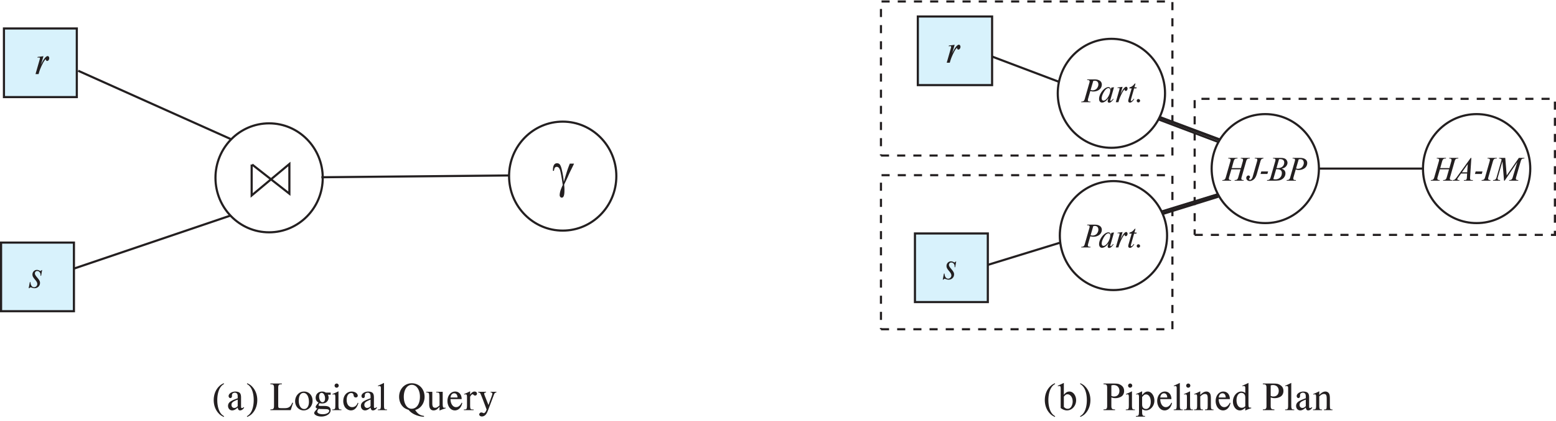
Blocking Operations
Blocking operations: cannot generate any output until all input is consumed
E.g., sorting, aggregation, …
But can often consume inputs from a pipeline, or produce outputs to a pipeline
Key idea: blocking operations often have two suboperations
E.g., for sort: run generation and merge
For hash join: partitioning and build-probe
Treat them as separate operations

Slide 146
Pipeline Stages
Pipeline stages:
All operations in a stage run concurrently
A stage can start only after preceding stages have completed execution

Slide 147
Evaluation Algorithms for Pipelining
Some algorithms are not able to output results even as they get input tuples
E.g., merge join, or hash join
intermediate results written to disk and then read back
Algorithm variants to generate (at least some) results on the fly, as input tuples are read in
E.g., hybrid hash join generates output tuples even as probe relation tuples in the in-memory partition (partition 0) are read in
Double-pipelined join technique: Hybrid hash join, modified to buffer partition 0 tuples of both relations in-memory, reading them as they become available, and output results of any matches between partition 0 tuples
When a new r₀ tuple is found, match it with existing s₀ tuples, output matches, and save it in r₀
Symmetrically for s₀ tuples

Slide 148
Pipelining for Continuous-Stream Data
Data streams
Data entering database in a continuous manner
E.g., Sensor networks, user clicks, …
Continuous queries
Results get updated as streaming data enters the database
Aggregation on windows is often used
E.g., tumbling windows divide time into units, e.g., hours, minutes
Need to use pipelined processing algorithms
Punctuations used to infer when all data for a window has been received

Slide 149
Query Processing in Memory
Query compilation to machine code
Overheads of interpretation
E.g., repeatedly finding attribute location within tuple, from metadata
Overhead of expression evaluation
Compilation can avoid many such overheads and speed up query processing
Often via generation of Java byte code / LLVM, with just-in-time (JIT) compilation
Column-oriented storage
Allows vector operations (in conjunction with compilation)
Cache conscious algorithms

Slide 150
Cache Conscious Algorithms
Goal: minimize cache misses, make best use of data fetched into the cache as part of a cache line
For sorting:
Use runs that are as large as L3 cache (a few megabytes) to avoid cache misses during sorting of a run
Then merge runs as usual in merge-sort
For hash-join
First create partitions such that build+probe partitions fit in memory
Then subpartition further s.t. build subpartition+index fits in L3 cache
Speeds up probe phase significantly by avoiding cache misses
Lay out attributes of tuples to maximize cache usage
Attributes that are often accessed together should be stored adjacent to each other
Use multiple threads for parallel query processing
Cache misses leads to stall of one thread, but others can proceed

Slide 151
End of Chapter 15

